Slide 1


Prognostics and Health Management (PHM) Data Challenge
MACHINE TOOL WEAR
Anthony Thomas
Jordan Mendenhall
Ryan Richardson
Timothy Fajembola

Slide 2

Executive Summary
Researchers at Shanghai Jiao Tang University conducted a study that provided a template for building two CNN models. These models predicted tool wear using signal data from sensors on the milling machine.
The constructed models successfully identified underlying trends in the data and predicted tool wear with a degree of accuracy, but they did not completely match the accuracy level reported in the paper.
The models were compared and showed the attention mechanism improved performance on a held-out data set.
The models’ accuracy and robustness could be improved with more data.

Slide 3
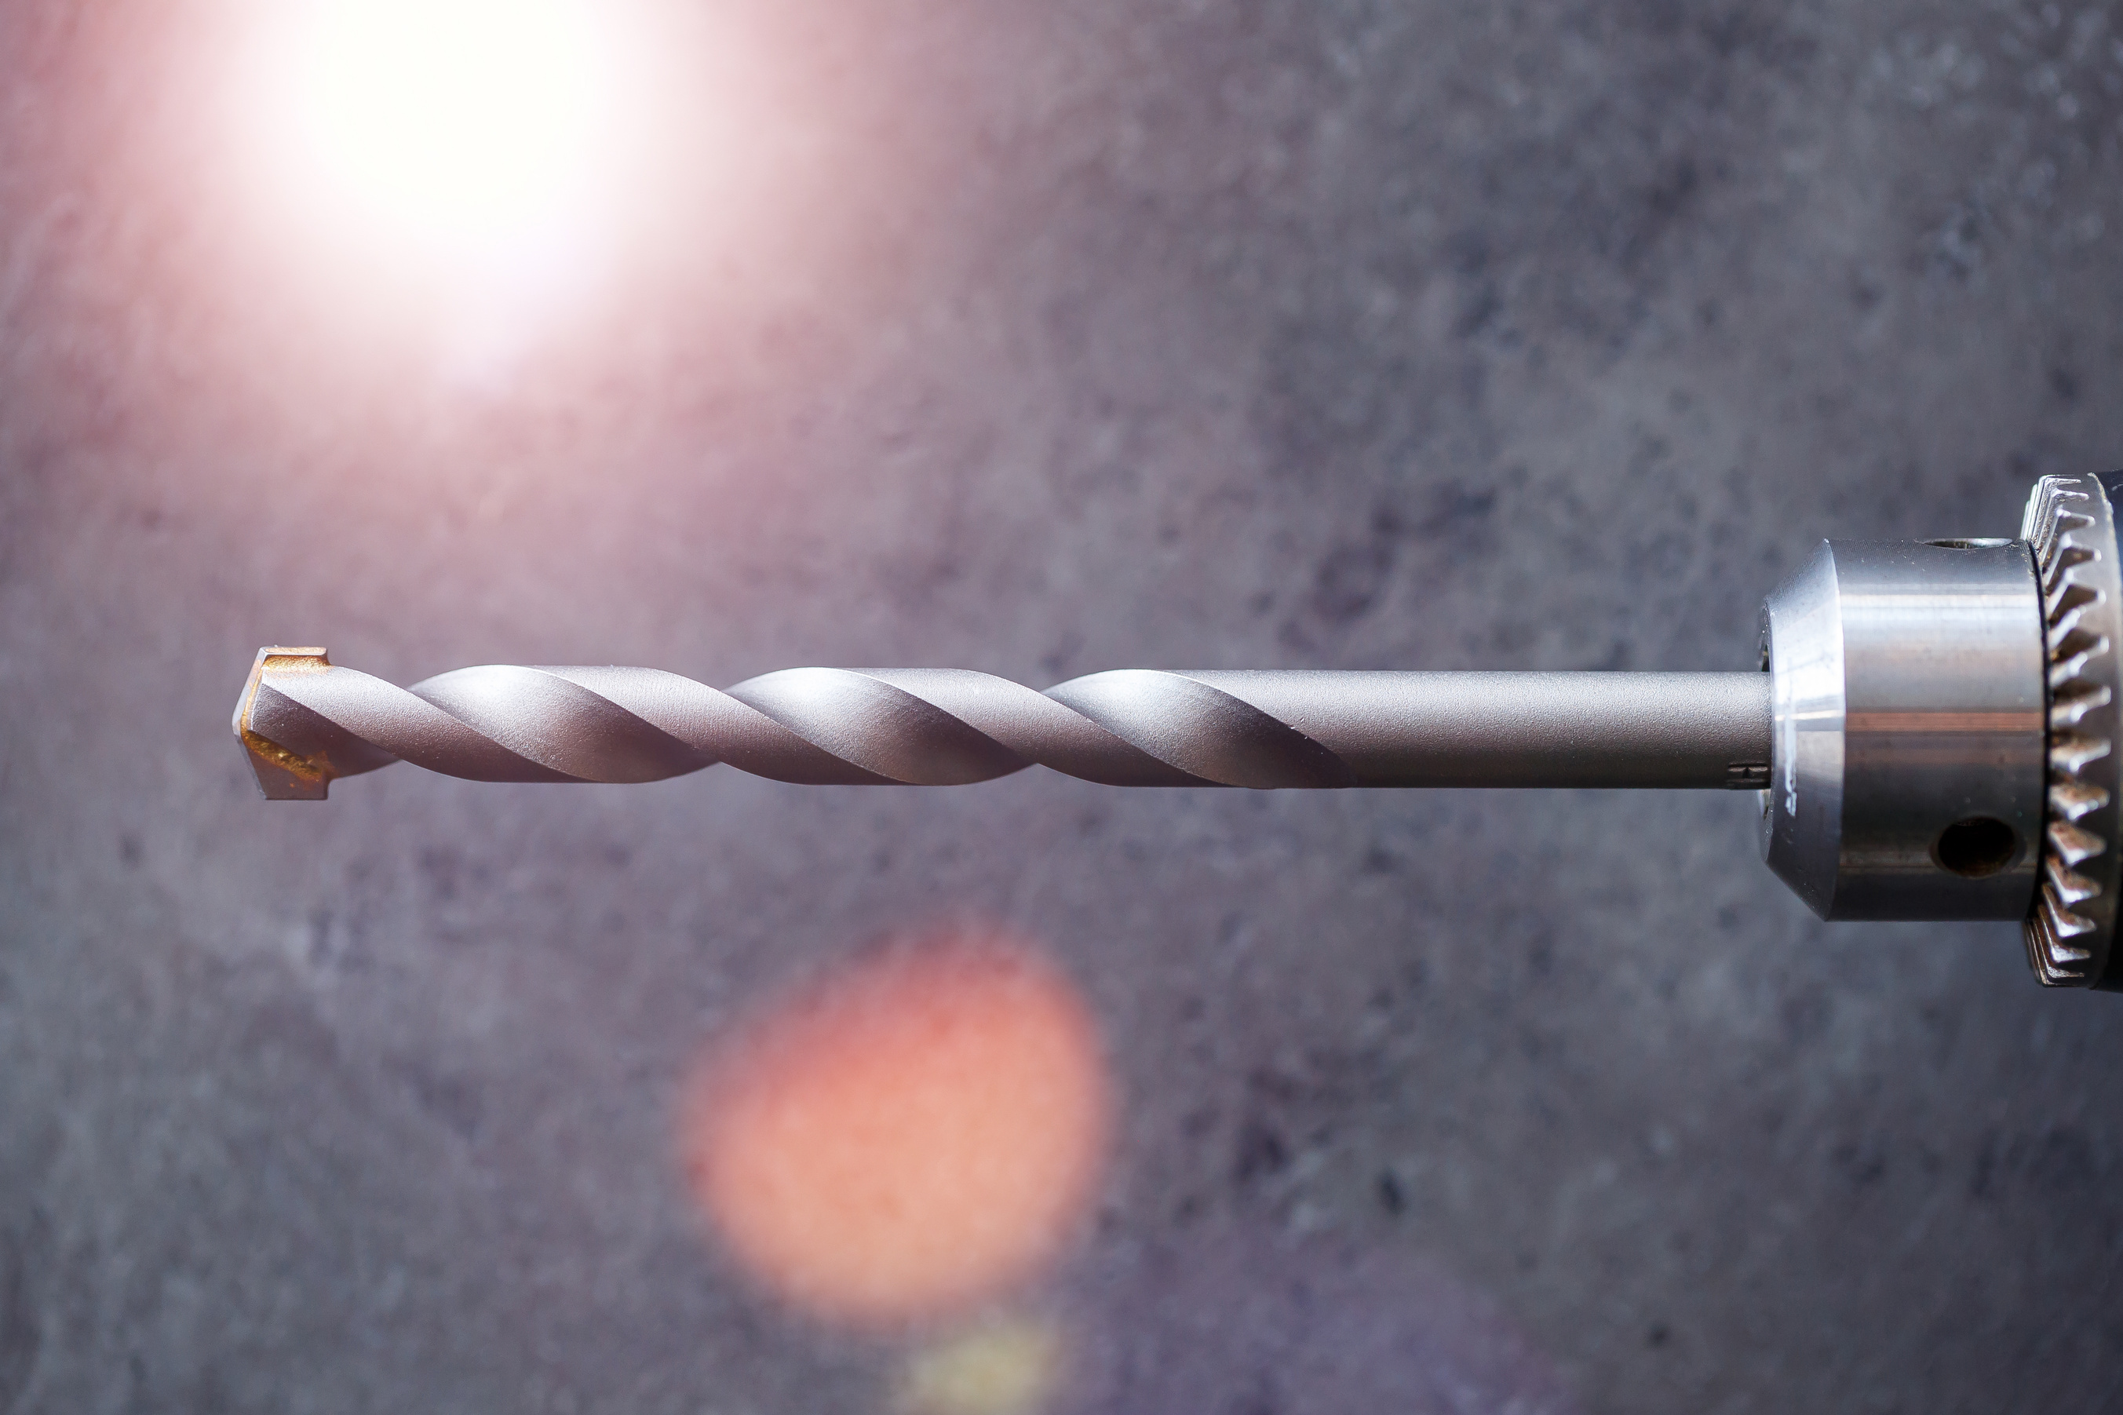
Project Rationale
01
02
03
04
Worn tools will produce
low-quality parts
Tool failures will
increase machine
downtime
Premature replacement will increase machine downtime
Up to $200 million in scrapped tools in the US in April 2018

Slide 4
Project Scope
01
02
03
Use signal data to build
CNN models with and
without an attention
mechanism to predict
tool wear
Quantify the
performance of
the models on a
test set
Compare the performance of the models to gauge the benefit of the attention mechanism

Slide 5
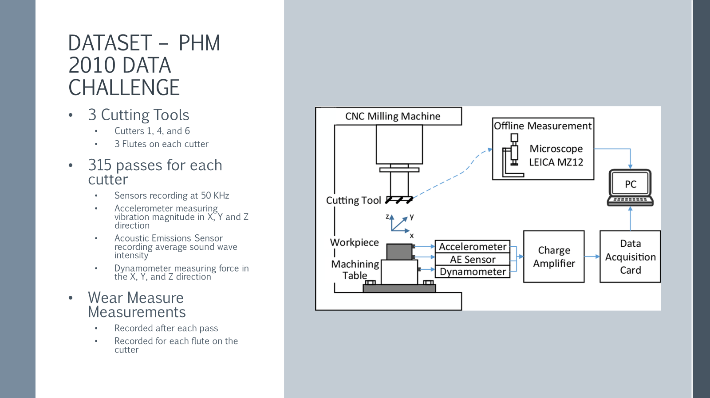

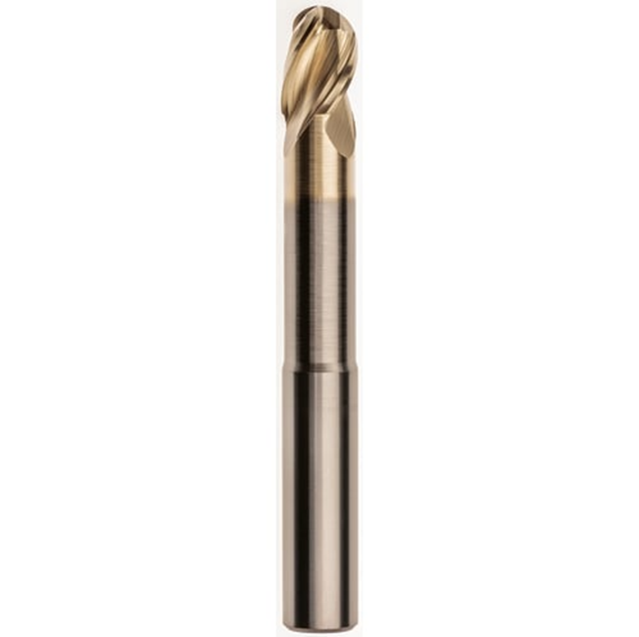

3-fluted Ball-nosed End Mill

Slide 6
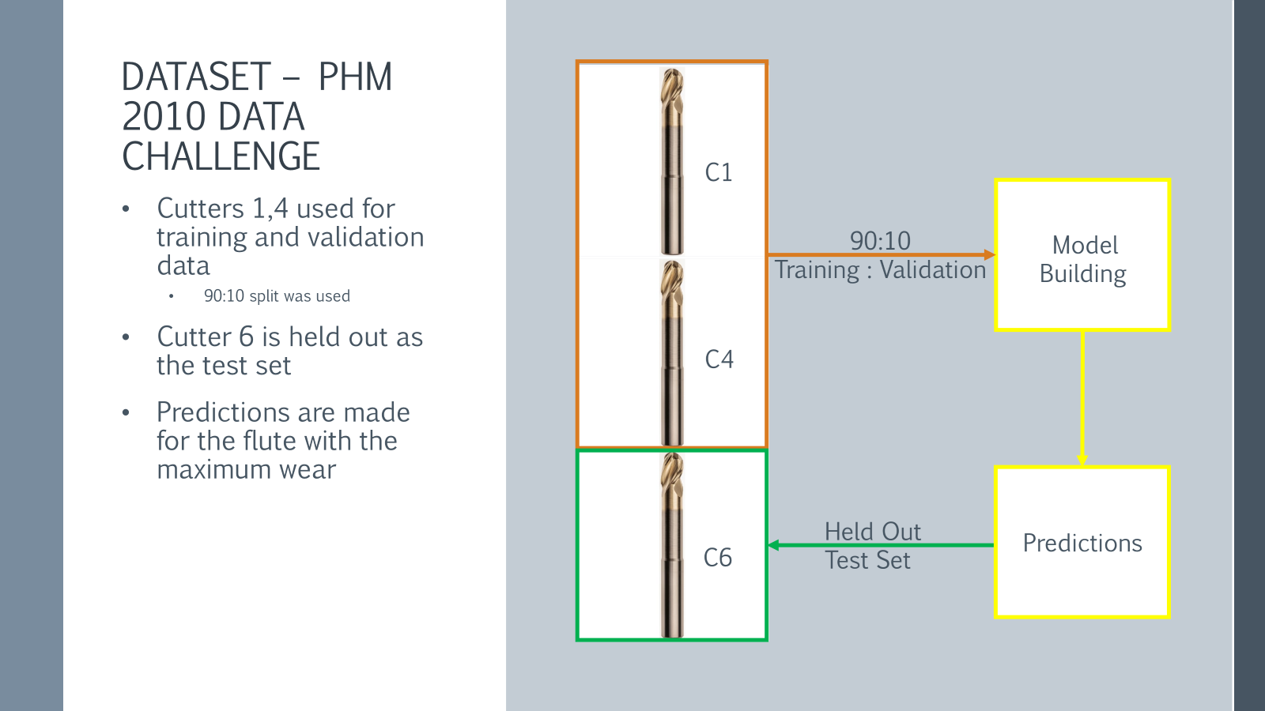


Slide 7
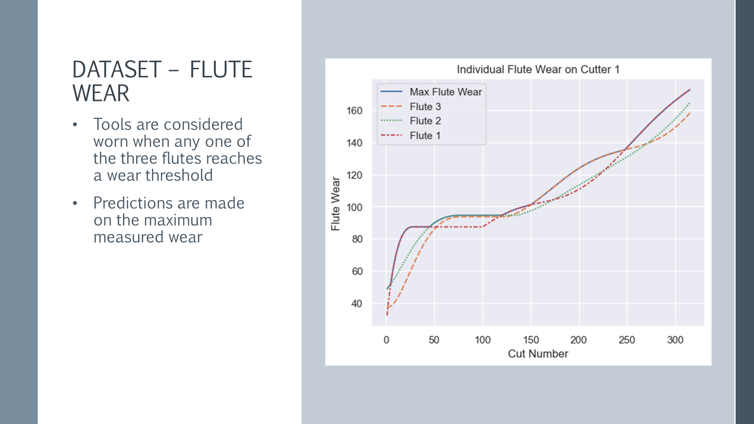


Slide 8
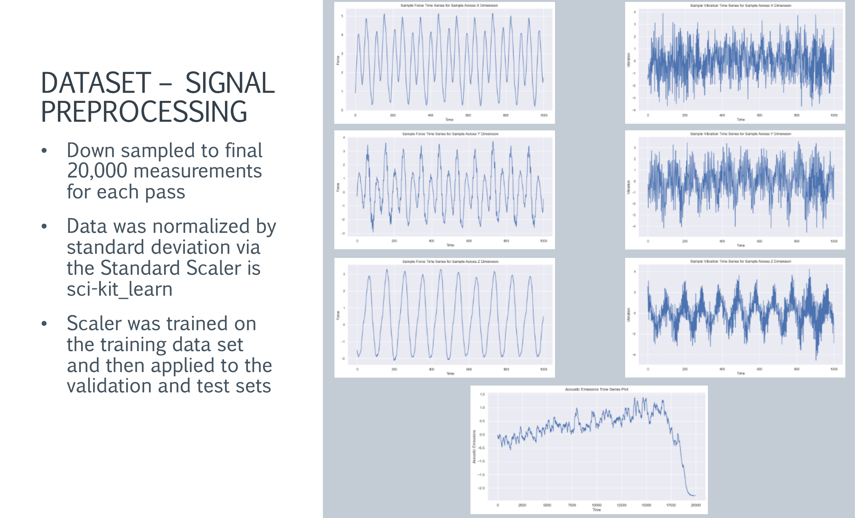


Slide 9
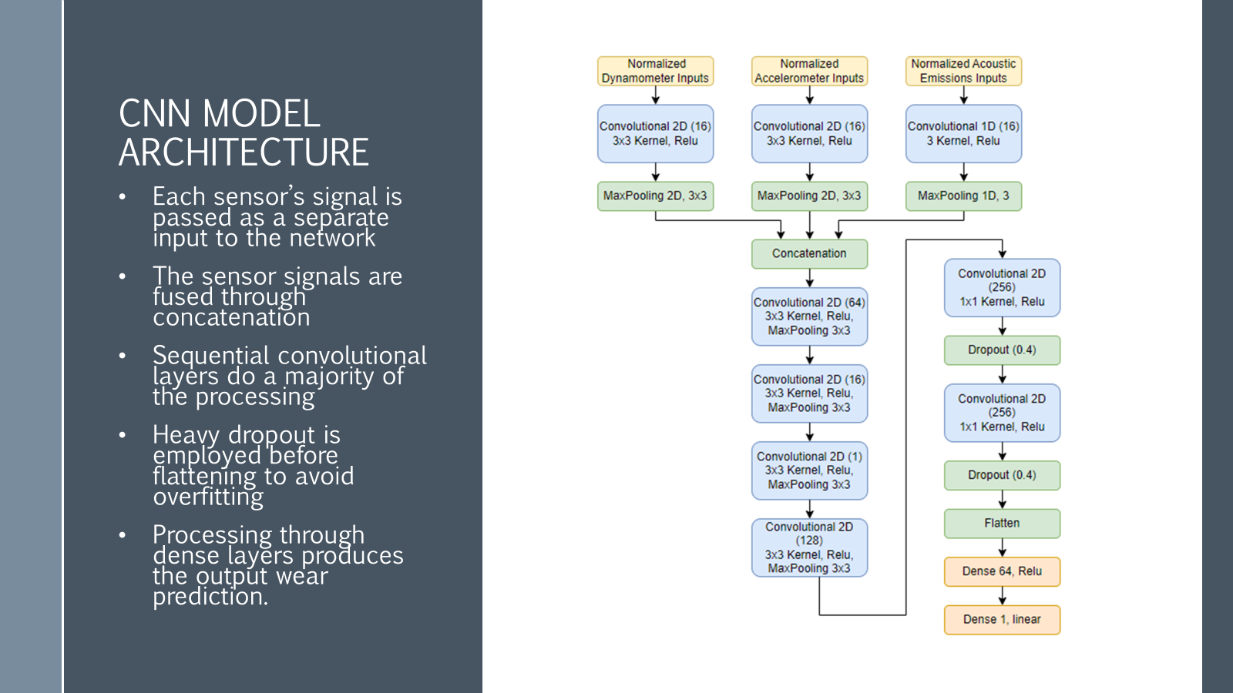


Slide 10
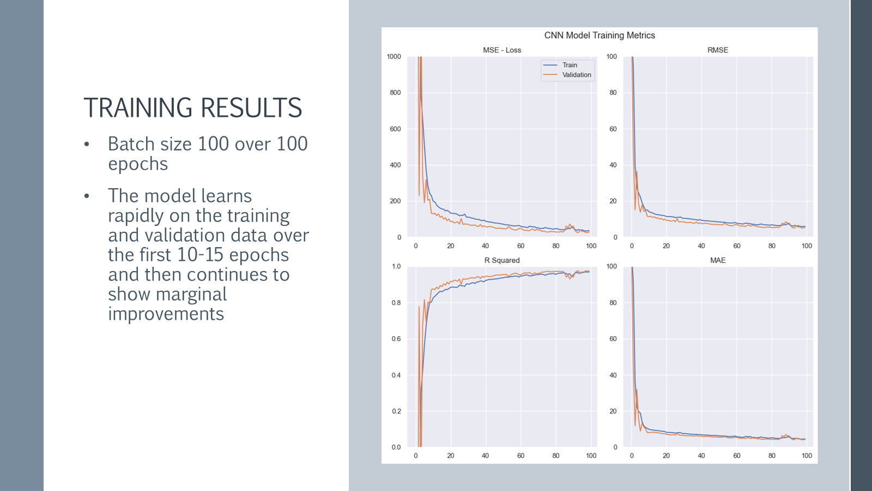


Slide 11
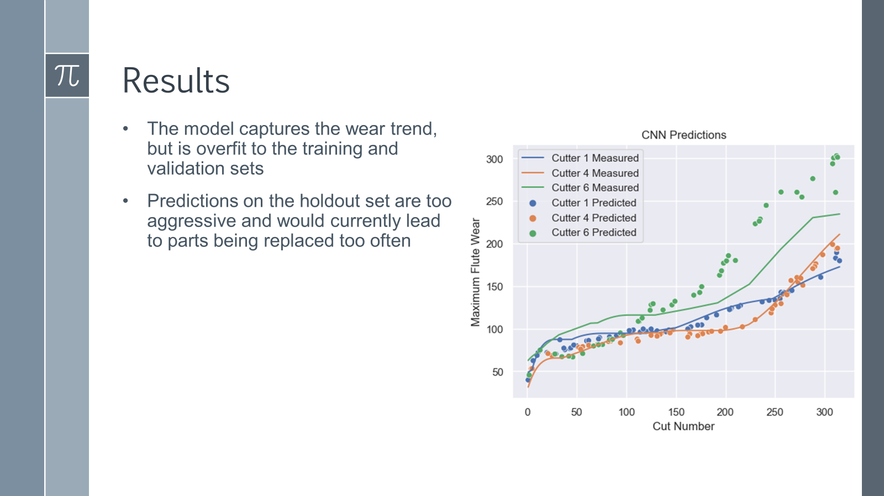


Slide 12
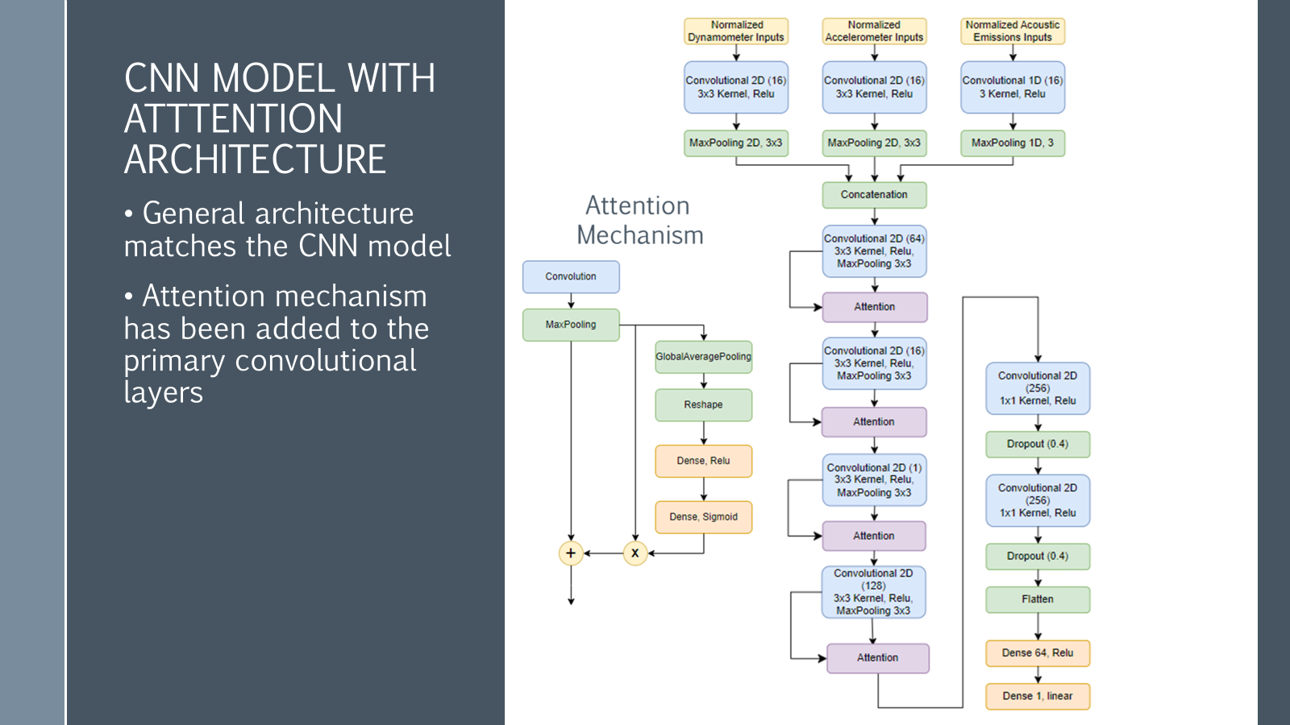


Slide 13
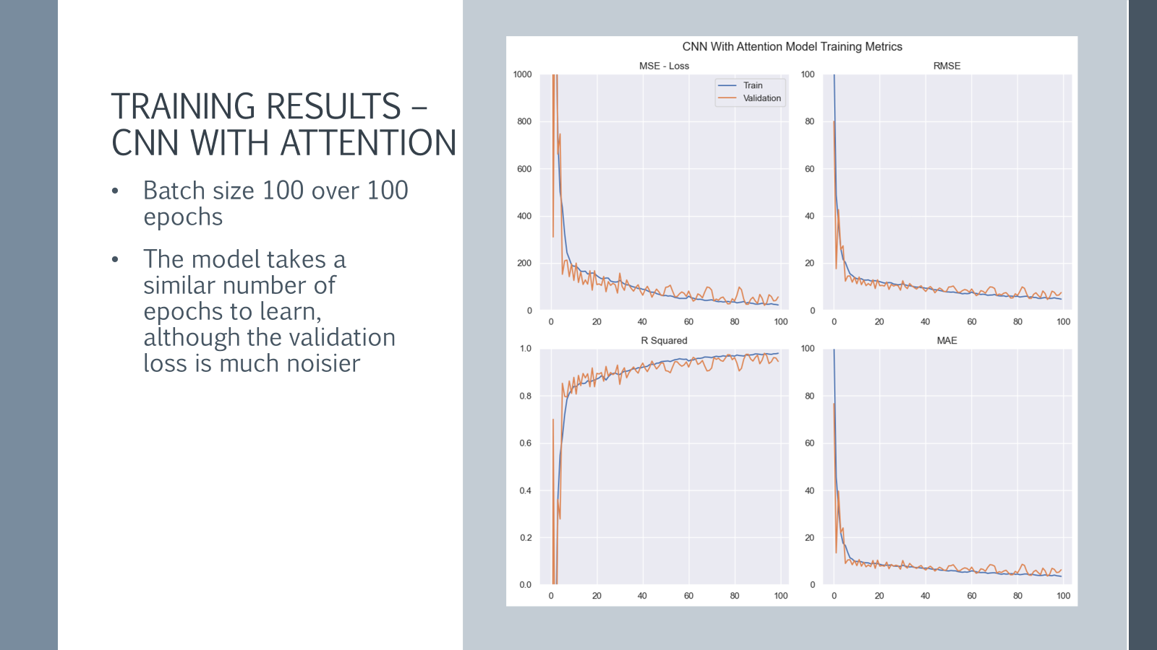


Slide 14
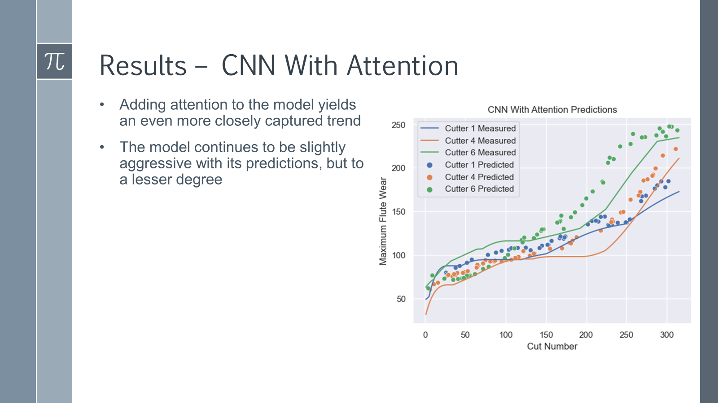


Slide 15
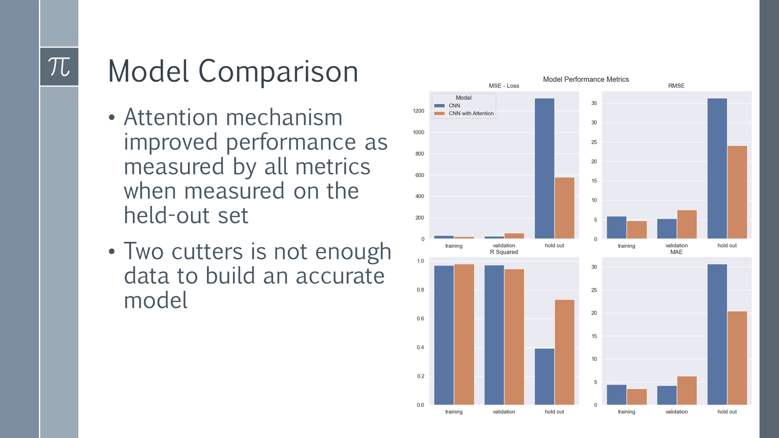



Slide 16

Where do we go from here?
Find additional datasets that include more cutters
Explore how the model handles different types of tools
Evaluate business cases for alternate model outputs

Slide 17
